Slide 1
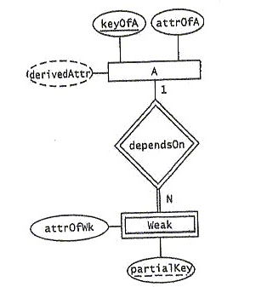
If you have any questions, email me at davidk6@gmail.com, with “CS561WS” in the subject line. If you don’t get a response within areasonable time, that means I’m offline, so phone me at 908-447-2346,but not before noon.
Good Luck
1. Translate the following ER diagram into an equivalent minimal storage relational design. (Be sure to include all necessary keys and foreign key references.)

Slide 2
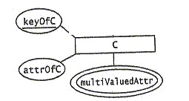
2. Translate the following ER diagram into an equivalent minimal storage relational design. (Be sure to include all necessary keys and foreign key references.)

Slide 3
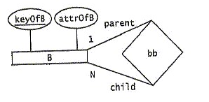
3. Translate the following ER diagram into an equivalent minimal storage relational design. (Be sure to include all necessary keys and foreign key references.)

Slide 4
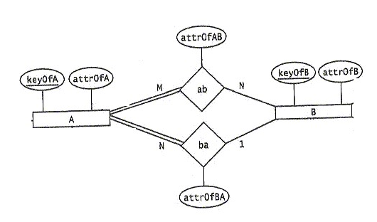
4. Translate the following ER diagram into an equivalent minimal storage relational design. (Be sure to include all necessary keys and foreign key references.)

Slide 5
5. Translate the following relational design into an equivalent ER diagram.
TABLE1
A B C D E
TABLE2
F G H I J
TABLE3
K L M N O

Slide 6
6. Consider the following table schema and functional dependencies:
- Table4(A, B, C, D, E, F, G)
- A->B
- GB->C
- GB->E
- GB->F
- C->D
- D->E
Find and remove all redundant left hand side attributes. Be sure to show all the details of how you arrived at your answer. (No credit otherwise)

Slide 7
7. Consider the following table schema and functional dependencies:
- Table5(A, B, C, D, E, F, G)
- A->B
- GB->C
- GB->E
- TB->F
- C->D
- D->E
Find a key for Table5 and show that it’s actually a key. (Recall that a set of attributes is not a key if some proper subset implies all the attributes.)

Slide 8
8. Consider the following table schema and sets of functional dependencies:
-Table6(A, B, C, D, E, F, G)
-F1 = {GFE->D, G->C, F->BA, CB->D}
-F2 = {G->C, F->BA, CB->D}
Determine if F1 is equivalent to F2. Be sure to show all the details of how you arrived at your answer. (No credit otherwise)

Slide 9
9. Consider the following table schema and functional dependencies:
- Table7(A, B, C, D, E)
- A->B
- B->C
- C->DE
- A->D
- A->E
Find and eliminate all redundant functional dependencies using the algorithm – not eyeballing, even if you’re able to. Be sure to show all the details of how you arrived at your answer. (No credit otherwise)

Slide 10
10. Consider the following table schema and functional dependencies:
- Table8(A, B, C, D, E, F)
- A->B
- B->C
- C->D
Normalize Table8. (Note that there are no redundant left hand side attributes and no redundant functional dependencies.)

Slide 11
11. Consider the following table schema and functional dependencies:
- Table9(A, B, C, D)
- A->BC
- B->A
- C->D
Normalize Table9. (Note that there are no redundant left hand side attributes and no redundant functional dependencies.)

